Slide 1
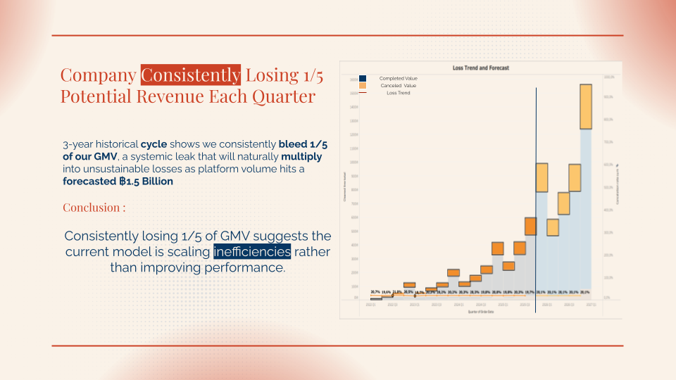
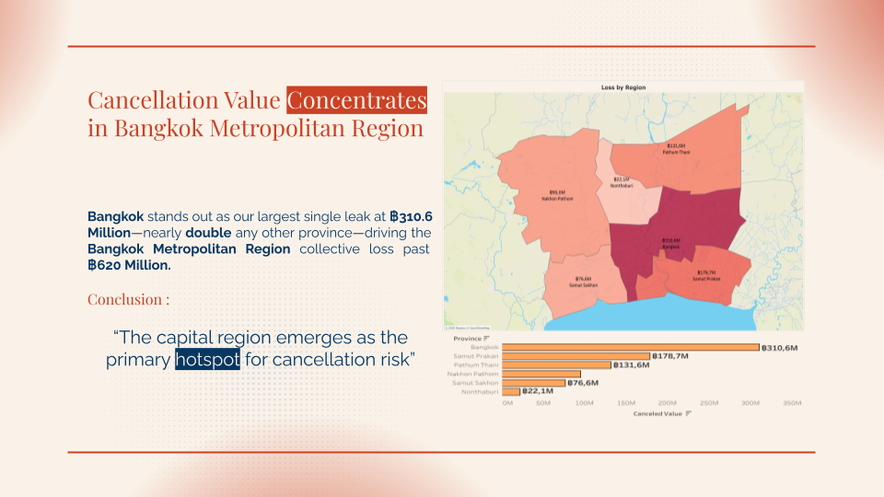
Project Summary
Title : Shopee Thailand Sales Performance
Scope : Cancelation Loss
Skills : Python, Tableau, Business Acumen, Data Preparation, EDA, Correlation, Pareto
Problem
Shopee Thailand experiences 20% Revenue Loss due to Cancelation, with value excess ฿800 Million in the past 3 years
Objective
Analyze Trends and patterns to find the best method to decrease loss due to cancellations to 10% by 2028
Findings
Cancellation value is not evenly distributed—it is heavily concentrated among high-volume transactions, the 20–40 customer segment, and core product categories like Home and Electronics.
Recommendation
Suppressive : High-Density Sales Interventions Preventive : Deploy Value-Based Retaining Triggers
Preservative : Standardize Cancellation Monitoring

